Slide 1

MINI PROJECT PRESENTATION ON
RFID Based Attendance System with Google Sheets using ESP8266
Under the Guidance of
Mr. ARUNAKUMAR S B
Assistant Professor
Department of ECE,
SKSVMACET, Lakshmeshwar
Presented By:
Darshan B V 2KA23EC009
Vivek Kumbar 2KA24EC407

Slide 2
Contents
Introduction
Objectives
Literature Survey
Methodology
Hardware and Software requirements
Advantages and Disadvantages
Applications
Expected Outcome
Conclusion

Slide 3
Introduction
Traditional attendance systems are time-consuming and
error-prone.
RFID (Radio Frequency Identification) technology offers
an efficient solution.
ESP8266 Wi-Fi module connects the system to the
internet.
Attendance is recorded automatically in Google Sheets
for easy access and monitoring.

Slide 4
Objectives
Automate the attendance marking system.
Reduce manual errors in attendance recording.
Provide real-time attendance updates through Google Sheets.
Make the system cost-effective and user-friendly.

Slide 5
Literature Survey
Author(s) & Year | Title / Source | Methodology / Technology Used | Key Findings / Contributions
Sharma et al. (2021) | RFID Based Attendance Monitoring System – IRJET | RFID cards with MFRC522 reader; ESP8266 microcontroller for data transfer; local database logging | Showed that RFID systems reduce proxy attendance and time consumption compared to manual methods.
Prasad (2022) | IoT Based Smart Attendance System Using RFID and Cloud Integration – IJCA | ESP8266 NodeMCU integrated with RFID reader; data sent to cloud server | Demonstrated IoT-based attendance with real-time monitoring accessible from anywhere.
Shinde (2020) | Implementation of IoT Based Attendance Monitoring System – IJARCCE | ESP8266 + RFID sending data to Google Sheets via Google Apps Script | Proposed Google Sheets as a free and scalable storage platform for attendance data.
Viral Science Creativity (2021) | ESP8266 RFID Attendance System with Google Sheets (Tutorial) | Practical step-by-step wiring + Arduino code + Google Apps Script | Provided a complete working prototype including circuit diagram, Arduino code, and Apps Script for integration.
Hackster.io Project (2020) | IoT Based RFID Attendance with NodeMCU | ESP8266 NodeMCU, MFRC522 RFID Reader, Google Apps Script endpoint | Illustrated simplified data flow and open-source code for rapid deployment.
Arduino.cc Forum Discussions (2019–2023) | “Smart Attendance – RFID and Google Sheet” threads | Troubleshooting and optimization tips for ESP8266 HTTP/HTTPS requests | Shared community-based improvements such as HTTPSRedirect library and error handling.

Slide 6
Methodology
RFID reader scans the student’s RFID card.
ESP8266 reads the card details and connects to Wi-Fi.
The data is sent to a Google Apps Script linked with
Google Sheets.
Google Sheet automatically updates attendance with
time and date.

Slide 7
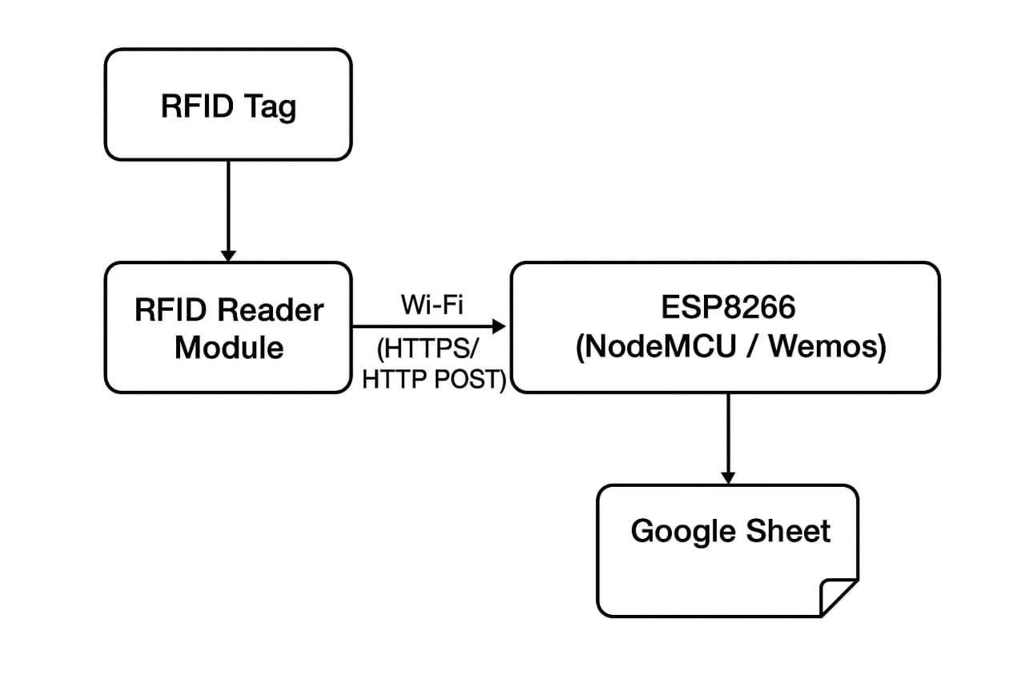
Block Diagram

Slide 8
Hardware and Software requirements
ESP8266 (NodeMCU)
RFID Reader (RC522)
RFID Tags / Cards
Jumper Wires & Breadboard
Power Supply
Arduino IDE
Google Apps Script
Google Sheets
RFID & ESP8266 libraries

Slide 9
Advantages
Automated and accurate system.
Easy integration with cloud (Google Sheets).
Reduces paperwork and human effort.
Real-time monitoring and data storage.
Disadvantages
  Limited to RFID card availability.
  Security depends on RFID tag protection.

Slide 10
Applications
Schools and Colleges for student attendance.
Offices for employee entry monitoring.
Libraries for book issue/return tracking.
Laboratories and restricted areas access control.

Slide 11
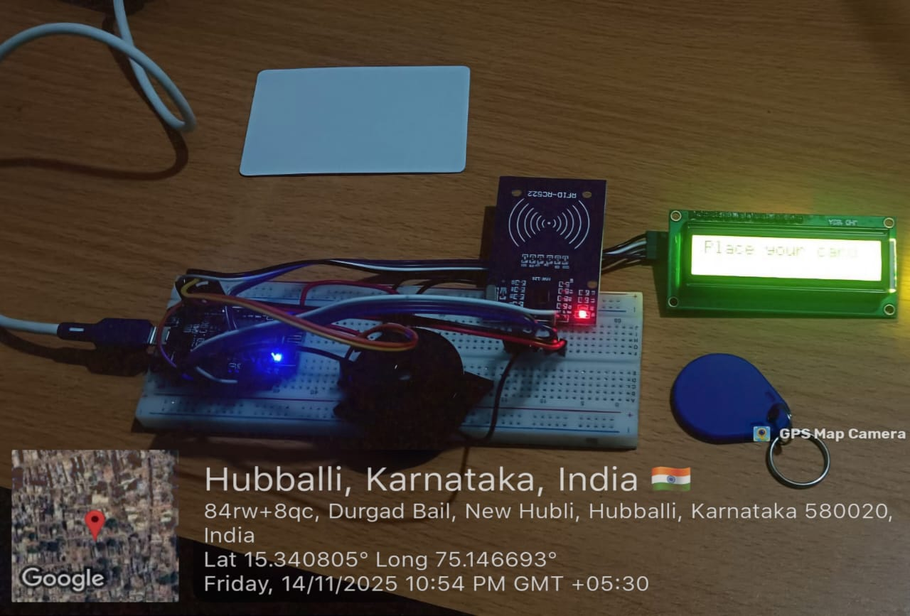
Expected Outcome:

Slide 12
Conclusion
RFID with ESP8266 provides a low-cost, efficient, and
reliable attendance system.
Real-time Google Sheets integration ensures transparency and
easy data handling.
This system can be widely implemented in educational institutions
and organizations.

Slide 13
References
S. K. Prasad, “IoT Based Smart Attendance System Using RFID and Cloud Integration,” International Journal of Computer Applications, 2022.
D. Sharma et al., “RFID Based Attendance Monitoring System,” International Research Journal of Engineering and Technology (IRJET), Vol. 8, Issue 6, 2021.
M. V. Shinde, “Implementation of IoT Based Attendance Monitoring System,” International Journal of Advanced Research in Computer and Communication Engineering, 2020.

Slide 14
THANK YOU

